Slide 1
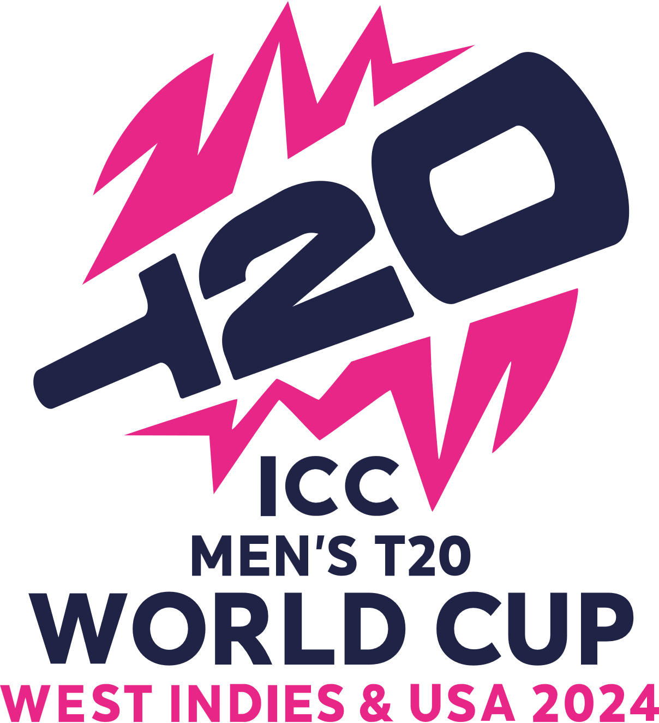
1 June – 29 June 2024

Slide 2
2024 ICC Men’s T20 World Cup
INTRODUCTION
The 2024 ICC Men's T20 World Cup was the ninth edition of the ICC Men's T20 World Cup. It was co-hosted by the West Indies and the United States from 1 to 29 June 2024; the tournament was hosted by the West Indies for the second time, and it was also the first major ICC tournament to feature matches played in the United States.
The tournament expanded from 16 to 20 teams, including the two hosts, the top eight teams from the 2022 edition, the two highest-ranked teams in the ICC Men's T20I Team Rankings not already qualified, and eight other teams determined through regional qualifiers. Canada and Uganda qualified for the men's T20 World Cup for the first time, while the United States participated for the first time by virtue of being co-hosts.
England were the defending champions and were beaten in the semi-finals by India, who went on to win their second T20 World Cup title, defeating South Africa by 7 runs and equalling England and West Indies with the most titles in the T20 World Cup while also becoming the first team in T20 World Cup history to win the title undefeated throughout the tournament.

Slide 3
2024 ICC Men’s T20 World Cup
Start from – 1 june to 29 june 2024
Administrator(s) - International Cricket Council
Cricket format - Twenty20 International
Tournament format(s)- Group stage, Super 8s and Knockout stage
Host(s)- West Indies, United States.

Slide 4
Background
The ICC Men's T20 World Cup is a professional T20I tournament held between men's national cricket teams, organized by the International Cricket Council (ICC). The tournament, now being held every two years, was first played in 2007 in South Africa. The last tournament, held in 2022 in Australia, was contested by 16 teams. The defending champions were England, who defeated Pakistan in the final of the previous edition.

Slide 5
—SOMEONE FAMOUS
“This is a quote, words full of wisdom that someone important said and can make the reader get inspired.”

Slide 6
Format
The 20 qualifying teams were divided into four groups of five teams; all the five teams in a group played with all the others – for a total of ten matches – and the top two teams in each group advanced to the Super 8 stage. The advanced 8 teams were divided into two groups of four teams each based on pre-tournament seedings; all the advanced teams in an advanced group played with all the others in that group – for a total of six matches – and the top two teams in each advanced group advanced to the knockout stage. Prior to the tournament, the ICC announced the eight seeded teams for the Super 8 stage based on T20I rankings. On advancing from the group stage, they were placed in pre-determined positions in the Super 8 stage, irrespective of their position in the group stage. If an unseeded team qualified at the expense of a seeded team, it took the position of the corresponding seeded team that failed to qualify from the group.

Slide 7
Prize Money
Place | Teams | Amount
 |  | Per Team | Total
Champions | 1 | $2.45 million | $2.45 million
Runners-up | 1 | $1.28 million | $1.28 million
Semi-finalists | 2 | $787,500 | $1.575 million
5th–8th place (Super 8) | 4 | $382,500 | $1.53 million
9th–12th place (Group stage) | 4 | $247,500 | $0.99 million
13th–20th place (Group stage) | 8 | $225,000 | $1.8 million
Match winners | 52 | $31,154 | $1.62 million
Total | 20 | $11.25 million | $11.25 million
.

Slide 8
Prize Money (cont.)
The ICC allocated a pool of US$11.25 million in prize money for the tournament. The winners would earn at least $2.45 million, the highest prize money in the history of the tournament. In addition, each team received an additional $31,154 for each match they win excluding the semi-finals and final.
Group Stage
ICC announced the groups and its fixtures on 5 January 2024, with the group stage matches being played from 1 to 17 June 2024. The 20 teams were divided into four groups of five with each team facing the other teams in the group for a total of 40 matches. The opening match was played with co-hosts United States facing Canada in the first ever T20I match at Grand Prairie Stadium on 1 June. The Nassau County Stadium at New York hosted its first ever international match on 3 June between South Africa and Sri Lanka.

Slide 9
Gropu Stage (Cont.)
Group Stage
Group A | Group B | Group C | Group D
Canada India Ireland Pakistan | Australia England Namibia Oman Scotland | Afghanistan New Zealand Papua New Guinea Uganda West Indies | Bangladesh Nepal Netherlands South Africa Sri Lanka
Source: ESPNcricinfo

Slide 10
Semi-Final
In the first semi-final, Afghanistan won the toss and chose to bat.[172] Afghanistan scored just 56 runs in 11.5 overs before being bowled out.[173] South Africa would go on to score 60 runs in 8.5 overs winning the match.[173] This was the first time that South Africa has reached the finals of an ICC Men's T20 World Cup.[174] It was also an historical low for Afghanistan and is their lowest ever score in T20Is.[172] Afghanistan's score was also the lowest ever score scored in an ICC Men's T20 World Cup semi-final.[175] The player of the match award was awarded to South African all-rounder Marco Jansen for taking 3 Afghani wickets.
In the second semi-final, India managed to score 171 for the loss of 7 wickets throughout a rain-affected innings. Indian captain Rohit Sharma scored 57 out of 39 balls while England's Chris Jordan took 3/37 in 3 overs.[176] In the second innings with the highest score being 25 off of 19 balls by Harry Brook England were bowled out for 103 in 16.4 overs. India's Kuldeep Yadav took 3/19 in 4 overs.[176] Indian spinner Axar Patel was awarded with the Player of the match award.[177] India qualified for their third T20 World Cup final after previously having won the tournament in 2007 and being runner-up in 2014.

Slide 11
Final
South Africa, after losing the toss, took three early Indian wickets of skipper Rohit Sharma, Rishabh Pant, and Suryakumar Yadav. However, Virat Kohli and Axar Patel put on a 72-run partnership, with Patel contributing 47 runs. Kohli's 76-run innings and a late contribution of 27 by Shivam Dube helped India reach a total of 176/7, the highest first-innings total in a T20 World Cup final.
South Africa's chase began with the loss of two early wickets, but Quinton de Kock and Tristan Stubbs took the total to 106. After they were both dismissed, Heinrich Klaasen made the fastest fifty in a World Cup final, including scoring 24 runs off the 15th over bowled by Axar Patel. At this point, South Africa required 30 runs in 30 balls with six wickets in hand. However, Arshdeep Singh, Jasprit Bumrah, and Hardik Pandya bowled economically in the last 5 overs. Pandya picked up the wicket of Klaasen in the 17th over, Bumrah dismissed Marco Jansen in the 18th over, and Pandya dismissed David Miller, the last recognized batsman, off the first ball of the final over. The tail end batsmen were unable to overhaul India's total, and South Africa ended their innings on 169/8, losing by 7 runs.[180]

Slide 12
Final (contd.)
This victory marked India's first ICC title since the 2013 ICC Champions Trophy, their first world cup title since the 2011 ICC Cricket World Cup, and their second T20 World Cup crown with the first being the 2007 title. Kohli's knock of 76 runs off 59 balls (including 6 fours and 2 sixes) earned him the Player of the Match award, while Jasprit Bumrah received the Player of the Tournament award for his outstanding bowling performance throughout the tournament. Bumrah ended up with 15 wickets with an economy rate of 4.17 towards the end of the tournament.[181] Kohli, Sharma and Jadeja announced their retirement from the T20 international format after the final.[182] The end of the tournament also marked the end of Rahul Dravid's tenure as the coach of the Indian cricket team as his contract was actually extended after the 2023 Cricket World Cup until this T20 World Cup.
The End
Thank You

